Slide 1
Traffic Incidents Across Calgary’s Neighbourhoods
DATA PROJECT · MIDPOINT REPORT
Where, when and who: the socioeconomic patterns behind 58,536 incidents, 2017–2025
Adrian Julve · [Course] · [Date]
Notes:
Hi, I’m Adrian. My project looks at traffic incidents in Calgary and asks whether they follow neighbourhood income and other socioeconomic conditions. The grid on the right is the colour key from my main map, which I’ll come back to. In the next five minutes I’ll cover the project, my questions, the data, how I cleaned it, and what the dashboard shows so far.

Slide 2
Project overview
Traffic incidents aren’t spread evenly across Calgary. This project asks whether neighbourhood income and other socioeconomic conditions help explain where, and when, they happen.
AREA
PERIOD
OUTPUT
City of Calgary, 113 community service areas
2017–2025, nine complete years
An interactive, single-page Power BI dashboard
Notes:
Traffic incidents aren’t random. They cluster on certain roads, at certain times, and in certain parts of the city. My project uses City of Calgary open data to ask whether neighbourhood income and related conditions, like renting, low income and how people commute, line up with where incidents happen. The study area is the whole city, split into 113 community service areas. I use nine complete years, 2017 to 2025, and the result is an interactive Power BI dashboard.

Slide 3
Analysis questions
01
WHERE
Where do incidents concentrate once population is accounted for, and does that match neighbourhood income?
02
WHO
Which other neighbourhood traits, such as renting, low income and commuting, go with higher incident rates?
03
WHEN
When do incidents happen, by hour of day, day of week and month of year?
Notes:
I have three questions. First, where: once we account for how many people live in an area, where do incidents concentrate, and does that match neighbourhood income? Second, who: beyond income, which neighbourhood traits, like renting, low income or commuting by car, go along with higher incident rates? Third, when: what times of day, days of the week and months of the year see the most incidents? Each question maps to a part of the dashboard.

Slide 4
Datasets obtained
Dataset | Source | What it holds | Size | Role
Traffic Incidents | City of Calgary Open Data | Location, description and time of each reported incident | 65,138 records | The events analysed
Equity Index Overlay Statistics | City of Calgary Open Data | Population, median income and 16 other measures per area (2021 Census), plus area boundaries | 113 areas | Who lives where
Community District Boundaries | City of Calgary Open Data | Community name, land-use class and development era | 313 communities | Residential filter, area names
Notes:
All three datasets come from the City of Calgary’s open data portal, and all are obtained. Traffic Incidents is the core: 65,138 records, each with a location, description and timestamp. The Equity Index file covers 113 community service areas with population, median income and 16 other census measures, plus their boundaries. Community District Boundaries adds 313 communities with their land-use class, which lets me separate residential areas from industrial ones.

Slide 5
Data wrangling and cleaning
Linked incidents to areas
Tidied the census data
Used local time
Matched each incident’s location to the neighbourhood it happened in.
Rearranged it into one row per area and fixed the number formats.
Converted times to Calgary time, then added hour, day and month.
Sorted incidents
Made areas comparable
Kept full years
Grouped them by type and flagged major highways like Deerfoot Trail.
Counted incidents per 1,000 residents a year, on local roads in residential areas.
Used 2017–2025 only, 58,536 incidents, and noted months missing from the data.
Notes:
Most of the work so far has been getting the data ready. Each incident only came with a location, so I matched it to the neighbourhood it happened in. The census data needed rearranging into one row per area. Times were stored in a different time zone, so I converted them to Calgary time and added the hour, day and month. I grouped incidents by type and flagged major highways. To compare areas fairly, I counted incidents per 1,000 residents a year, using local roads in residential areas, so highways and industrial zones don’t skew the results. Finally, I kept only the nine complete years.

Slide 6

The dashboard so far
BUILT
4 KPIs that follow the filters
Income × incident-rate map
Click-through area details
Day-by-hour heatmap
Monthly pattern
Neighbourhood-trait links
Year, type and community filters
Notes:
This is the dashboard as it stands. Across the top are four KPIs that update with the filters. The main visual is a bivariate map: each area is coloured by its median income and its incident rate at the same time, and clicking an area or a legend square fills in the details panel. On the right are the time patterns, and in the bottom right a chart linking incident rates to other neighbourhood traits. Everything responds to the year, incident type and community type filters.

Slide 7
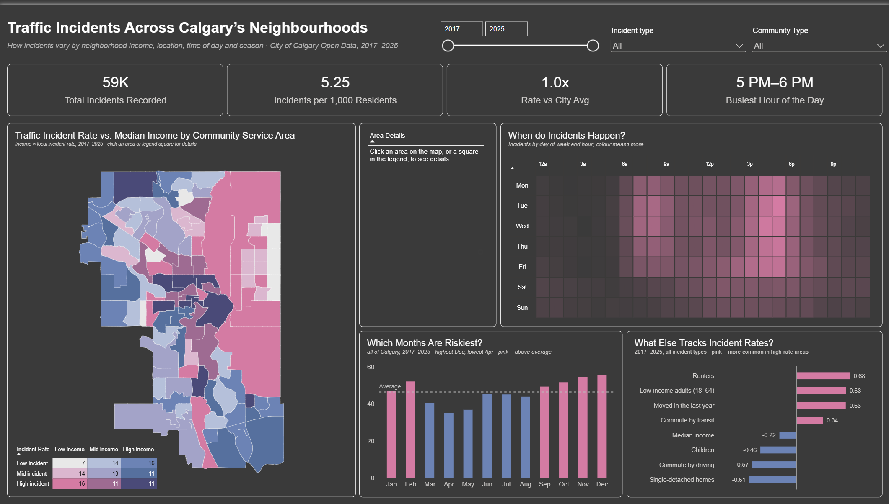
The dashboard so far
BUILT
4 KPIs that follow the filters
Income × incident-rate map
Click-through area details
Day-by-hour heatmap
Monthly pattern
Neighbourhood-trait links
Year, type and community filters
Notes:
This is the dashboard as it stands. Across the top are four KPIs that update with the filters. The main visual is a bivariate map: each area is coloured by its median income and its incident rate at the same time, and clicking an area or a legend square fills in the details panel. On the right are the time patterns, and in the bottom right a chart linking incident rates to other neighbourhood traits. Everything responds to the year, incident type and community type filters.

Slide 8
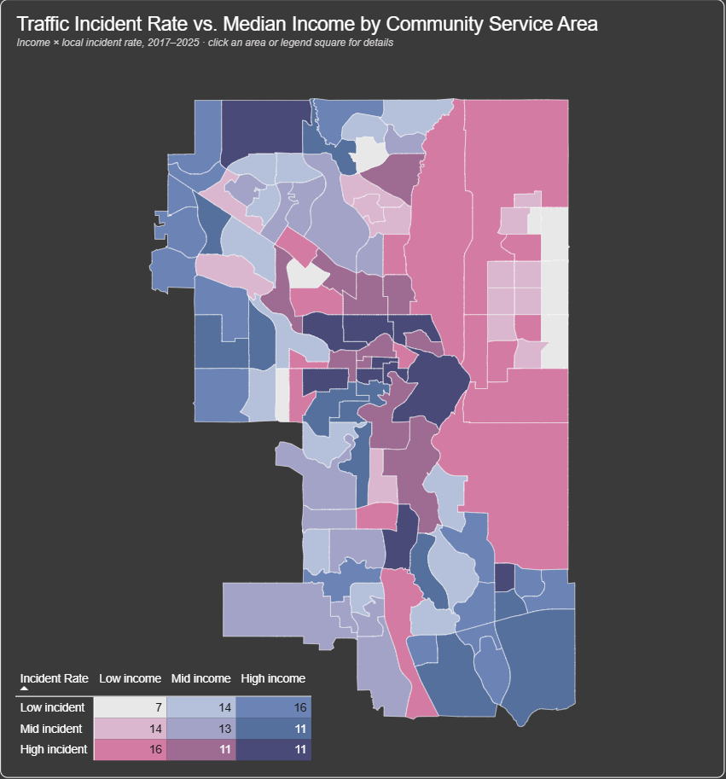
Findings: where and who
16 of 37
lower-income areas fall in the highest incident-rate third, vs. 11 of 38 higher-income areas
1.7×
the local incident rate in the lowest-income fifth (2.35 vs. 1.38 per 1,000 residents a year)
+0.68 vs. −0.22
renter share tracks incident rates far more closely than median income does
Notes:
Here’s what the data shows so far. Of the 37 lowest-income areas, 16 land in the highest incident-rate group, compared with 11 of the 38 highest-income areas. Grouped into fifths by income, the lowest-income fifth has about 1.7 times the local incident rate of the highest. But income alone is a weak signal: its correlation is only minus 0.22. Renter share, at plus 0.68, and the share of low-income adults and recent movers, both around 0.63, track incident rates much more closely. Car-oriented suburbs of detached homes have the lowest rates. So housing and mobility seem to matter more than income itself.

Slide 9
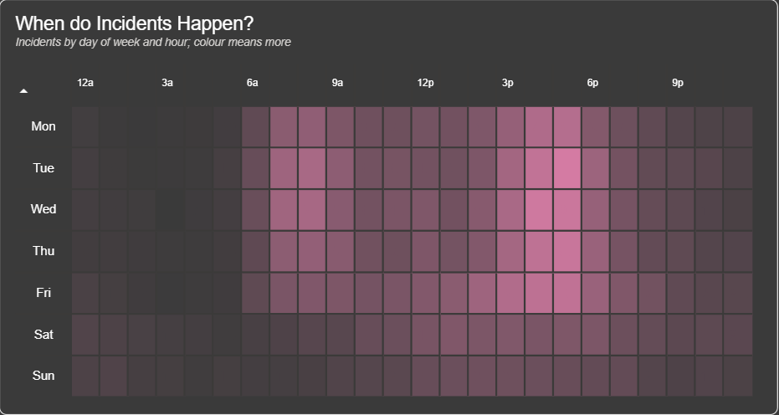
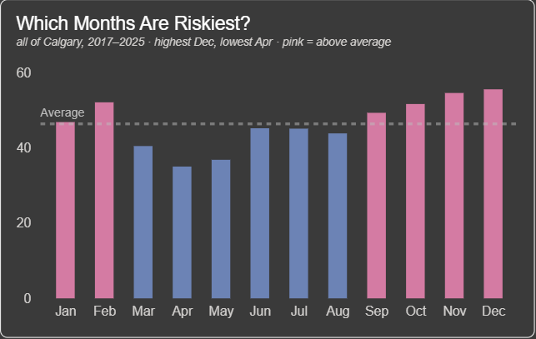
Findings: when
December runs 1.6× April (55.5 vs. 35.0 per 100,000 residents a month). Fall and winter sit above average.
26% of incidents happen between 3 and 6 PM, peaking 5–6 PM. Sundays see about half of Wednesday’s total.
Notes:
The time patterns are clear. The heatmap shows incidents concentrate on weekday afternoons: about a quarter of all incidents happen between 3 and 6 PM, and 5 to 6 PM is the single busiest hour, which lines up with the evening commute. Weekends are much quieter; Sunday has about half as many incidents as Wednesday. By month, the rate climbs through fall and peaks in November and December, at about 1.6 times April’s rate, which points to winter driving conditions and shorter daylight.

Slide 10
Next steps
Account for traffic, not just residents
Look at who gets hurt
Downtown and industrial areas draw commuters, so a resident-based rate overstates them.
Compare pedestrian and cyclist incidents across income groups.
Track the gap over time
Write up the limits
Test whether the difference between income groups has grown since 2020.
These are area-level patterns, not individual risk, and correlation, not cause.
Questions?
Notes:
For the second half, I have four next steps. First, the rate uses residents, which overstates places like downtown and the industrial east that pull in commuters, so I want to account for traffic volume. Second, I want to look at who is hurt, comparing pedestrian and cyclist incidents across income groups. Third, I’ll test whether the gap between income groups has grown since 2020. And finally, I’ll write up the limits: these are patterns across areas, not individual risk, and correlations don’t show cause. Thanks, and I’m happy to take questions.

